Slide 1



Augmenting Datacenter Switch Buffer Sharing with
ML Predictions
Vamsi Addanki, Maciej Pacut, Stefan Schmid
Notes:
Hello everyone, Thanks for joining the session. I am Vamsi Addanki. Today, I will be presenting Credence and the benefits of augmenting switch buffer sharing with machine-learned predictions.
This is a joint work with Maciej and Stefan. We are from the intelligent networks groups at TU Berlin.
Before going into the technical details of this work, lets play a game first.

Slide 2
Let’s Play a Game
Event venue
Notes:
Consider an Event Venue.

Slide 3

Let’s Play a Game
Entry
A
B
C
D
Event venue
Notes:
The venue has 4 entry gates

Slide 4
Let’s Play a Game
Entry
A
B
C
D
Event venue
Exit
1
2
3
4
Notes:
4 exit gates

Slide 5
Let’s Play a Game
Entry
A
B
C
D
Event venue
Capacity: 6
Exit
1
2
3
4
Notes:
And the venue actually has a capacity limit of accommodating 6 people.

Slide 6

Let’s Play a Game
Entry
A
B
C
D
Event venue
Bouncer
Capacity: 6
Exit
1
2
3
4
Notes:
Due to the capacity limits, the venue also hired a bouncer to manage the entry into the venue.

Slide 7

Let’s Play a Game
Arrivals: 4
A
B
C
D
Capacity: 6
1
2
3
4
Notes:
Lets start the game. 4 people arrived.

Slide 8
Let’s Play a Game
Arrivals: 4
A
B
C
D
Capacity: 6
1
2
3
4
Notes:
The bouncer allowed everybody in. In this game, people have a specific exit in mind, when they enter. In this round, all the 4 people go to exit number 1.

Slide 9
Let’s Play a Game
Arrivals: 4
A
B
C
D
Score: 1
Capacity: 6
1
2
3
4
Notes:
Only one person at a time can go out of each exit. When a person leaves, the bouncer gets a score of 1. So the current score is 1 for the bouncer.

Slide 10
Let’s Play a Game
Arrivals: 8
A
B
C
D
Score: 1
Capacity: 6
1
2
3
4
Notes:
4 more people arrive.

Slide 11
Let’s Play a Game
Arrivals: 8
A
B
C
D
Score: 1
Capacity: 6
1
2
3
4
Notes:
3 go the first exit and the last one going to exit 3 does not have enough space in the venue. So the bouncer rejects this person.

Slide 12
Let’s Play a Game
Arrivals: 8
A
B
C
D
Score: 2
Capacity: 6
1
2
3
4
Notes:
Again, one person leaves from the exit. So the bouncer’s score increases by 1.

Slide 13
Let’s Play a Game
Arrivals: 12
A
B
C
D
Score: 2
Capacity: 6
1
2
3
4
Notes:
This repeats. 4 more new arrivals

Slide 14
Let’s Play a Game
Arrivals: 12
A
B
C
D
Score: 2
Capacity: 6
1
2
3
4
Notes:
This time, each person goes to a different exit. Due to the capacity limit, 3 people get rejected by the bouncer.

Slide 15
Let’s Play a Game
Arrivals: 12
A
B
C
D
Score: 3
Capacity: 6
1
2
3
4
Notes:
One person goes out of exit and the bouncer’s score increases by 1.

Slide 16
Let’s Play a Game
Arrivals: 16
A
B
C
D
Score: 3
Capacity: 6
1
2
3
4
Notes:
Same again. 4 more new people.

Slide 17
Let’s Play a Game
Arrivals: 16
A
B
C
D
Score: 3
Capacity: 6
1
2
3
4
Notes:
3 get rejected.

Slide 18
Let’s Play a Game
Arrivals: 16
A
B
C
D
Score: 4
Capacity: 6
1
2
3
4
Notes:
One goe out and the bouncer get 1 more point.

Slide 19
Let’s Play a Game
Arrivals: 20
A
B
C
D
Score: 4
Capacity: 6
1
2
3
4
Notes:
Same again.

Slide 20
Let’s Play a Game
Arrivals: 20
A
B
C
D
Score: 4
Capacity: 6
1
2
3
4

Slide 21
Let’s Play a Game
Arrivals: 20
A
B
C
D
Score: 5
Capacity: 6
1
2
3
4

Slide 22
Let’s Play a Game
Previous Game
Arrivals: 20
A
B
C
D
Score: 5
Capacity: 6
1
2
3
4
Notes:
And the game ends. In total we had 20 arrivals, and our score is only 5.

Slide 23
Let’s Play a Game
Previous Game
Arrivals: 4
Arrivals: 20
A
B
C
D
Score: 5
Capacity: 6
1
2
3
4

Slide 24
Let’s Play a Game
Previous Game
Arrivals: 4
Arrivals: 20
A
B
C
D
Score: 5
Capacity: 6
1
2
3
4

Slide 25
Let’s Play a Game
Previous Game
Arrivals: 4
Arrivals: 20
A
B
C
D
Score: 5
Score: 1
Capacity: 6
1
2
3
4

Slide 26
Let’s Play a Game
Previous Game
Arrivals: 8
Arrivals: 20
A
B
C
D
Score: 5
Score: 1
Capacity: 6
1
2
3
4

Slide 27
Let’s Play a Game
Previous Game
Arrivals: 8
Arrivals: 20
A
B
C
D
Score: 5
Score: 1
Capacity: 6
1
2
3
4

Slide 28
Let’s Play a Game
Previous Game
Arrivals: 8
Arrivals: 20
A
B
C
D
Score: 5
Score: 3
Capacity: 6
1
2
3
4

Slide 29
Let’s Play a Game
Previous Game
Arrivals: 12
Arrivals: 20
A
B
C
D
Score: 5
Score: 3
Capacity: 6
1
2
3
4

Slide 30
Let’s Play a Game
Previous Game
Arrivals: 12
Arrivals: 20
A
B
C
D
Score: 5
Score: 3
Capacity: 6
1
2
3
4

Slide 31
Let’s Play a Game
Previous Game
Arrivals: 12
Arrivals: 20
A
B
C
D
Score: 5
Score: 7
Capacity: 6
1
2
3
4

Slide 32
Let’s Play a Game
Previous Game
Arrivals: 16
Arrivals: 20
A
B
C
D
Score: 5
Score: 7
Capacity: 6
1
2
3
4

Slide 33
Let’s Play a Game
Previous Game
Arrivals: 16
Arrivals: 20
A
B
C
D
Score: 5
Score: 7
Capacity: 6
1
2
3
4

Slide 34
Let’s Play a Game
Previous Game
Arrivals: 16
Arrivals: 20
A
B
C
D
Score: 5
Score: 11
Capacity: 6
1
2
3
4

Slide 35
Let’s Play a Game
Previous Game
Arrivals: 20
Arrivals: 20
A
B
C
D
Score: 5
Score: 11
Capacity: 6
1
2
3
4

Slide 36
Let’s Play a Game
Previous Game
Arrivals: 20
Arrivals: 20
A
B
C
D
Score: 5
Score: 11
Capacity: 6
1
2
3
4

Slide 37
Let’s Play a Game
Previous Game
Arrivals: 20
Arrivals: 20
A
B
C
D
Score: 5
Score: 15
Capacity: 6
1
2
3
4

Slide 38
Let’s Play a Game
New Game
Previous Game
Arrivals: 20
Arrivals: 20
Score: 15
A
B
C
D
Score: 5
1
2
3
4

Slide 39
Let’s Play a Game
New Game
Previous Game
Arrivals: 20
Arrivals: 20
Score: 15
A
B
C
D
Score: 5
Admission Control Algorithms can improve throughput
(or severely impact throughput)
1
2
3
4

Slide 40
Buffer Sharing
Input Ports
A
B
C
D
Network
Switch
Shared Buffer
Buffer Sharing
Algorithm
1
2
3
4
Output Ports

Slide 41
Buffer Sharing: An Emerging Critical Problem
Bursty traffic requires buffers to avoid packet losses
Stringent performance requirements
But buffer sizes are unable to scale with capacity increase

Slide 42
Buffer Sharing: An Emerging Critical Problem
Bursty traffic requires buffers to avoid packet losses
Stringent performance requirements
But buffer sizes are unable to scale with capacity increase
Buffer Sharing algorithm can severely impact end-to-end performance e.g., FCTs

Slide 43
Buffer Sharing (An Online Perspective)
Goal: Maximize the number of transmitted packets
Throughput maximization

Slide 44
Buffer Sharing (An Online Perspective)
Goal: Maximize the number of transmitted packets
Throughput maximization
Online algorithm (ALG) takes spontaneous decisions upon every packet arrival

Slide 45
Buffer Sharing (An Online Perspective)
Goal: Maximize the number of transmitted packets
Throughput maximization
Online algorithm (ALG) takes spontaneous decisions upon every packet arrival
Offline optimal algorithm (OPT) has prior knowledge of the entire arrival sequence and performs optimally

Slide 46
Buffer Sharing (An Online Perspective)
ALG is C competitive if OPT transmits no more than C times that of ALG
OPT ≤ C ᐧ ALG

Slide 47
Buffer Sharing (An Online Perspective)
ALG is C competitive if OPT transmits no more than C times that of ALG
OPT ≤ C ᐧ ALG
Competitive Ratio

Slide 48
Online Buffer Sharing Algorithms
Drop-tail: Drop on arrival or accept
All commodity switches support drop-tail buffers
Push-out: Accept all packets and push a packet out when the buffer is full
Not supported in hardware

Slide 49
Competitive ratio
1
N
Optimal Throughput
Lower Throughput

Slide 50
Dynamic Thresholds
Complete Sharing
Harmonic
Competitive ratio
1
N
Optimal Throughput
Lower Throughput

Slide 51
Longest Queue Drop
(Push-out)
Dynamic Thresholds
Complete Sharing
Harmonic
Competitive ratio
1
1.707
N
Optimal Throughput
Lower Throughput

Slide 52
Not supported in hardware!
All commodity switches support drop-tail
LQD
(Push-out)
Dynamic Thresholds
Complete Sharing
Harmonic
Competitive ratio
1
1.707
N
Optimal Throughput
Lower Throughput

Slide 53
Not supported in hardware!
All commodity switches support drop-tail
Can we unlock this space?
LQD
(Push-out)
Dynamic Thresholds
Complete Sharing
Harmonic
Competitive ratio
1
1.707
N
Optimal Throughput
Lower Throughput

Slide 54
Limitations of Traditional Drop-tail Buffer Sharing
Proactive unnecessary drops →throughput loss

Slide 55
Limitations of Traditional Drop-tail Buffer Sharing
Proactive unnecessary drops →throughput loss
Overprovisioning for the unknown future arrivals
Packet drops are unnecessary if the future is known

Slide 56
Limitations of Traditional Drop-tail Buffer Sharing
Proactive unnecessary drops →throughput loss
Overprovisioning for the unknown future arrivals
Packet drops are unnecessary if the future is known
Reactive avoidable drops →throughput loss

Slide 57
Limitations of Traditional Drop-tail Buffer Sharing
Proactive unnecessary drops →throughput loss
Overprovisioning for the unknown future arrivals
Packet drops are unnecessary if the future is known
Reactive avoidable drops →throughput loss
Underprovisioning for the unknown future arrivals
Packet drops are avoidable if the future is known

Slide 58
Push-out
Drop-tail
LQD
(Push-out)
Dynamic Thresholds
Complete Sharing
Harmonic
Competitive ratio
1
1.707
N
Optimal Throughput
Lower Throughput

Slide 59
Predictions: A Hope for Competitive Buffer Sharing
Predict the actions of a push-out algorithm (LQD)
Augment drop-tail algorithms with predictions
Peek into the future

Slide 60
Predictions: A Hope for Competitive Buffer Sharing
Predict the actions of a push-out algorithm (LQD)
Augment drop-tail algorithms with predictions
Peek into the future
Can predictions improve drop-tail’s competitive ratio?

Slide 61
Naive Approach
Upon a packet arrival
Predict LQD’s action
If prediction is to accept, then accept
If prediction is to drop, then drop

Slide 62
Challenge: Imperfect Predictions
Ground Truth: Drop
Prediction: Drop
Ground Truth: Drop
Prediction: Accept
True Positive
False Negative
Ground Truth: Accept
Prediction: Drop
Ground Truth: Accept
Prediction: Accept
False Positive
True Negative

Slide 63
Challenge: Imperfect Predictions
Excessive false positives can lead to starvation
eg., every prediction is “drop”

Slide 64
Challenge: Imperfect Predictions
Excessive false positives can lead to starvation
eg., every prediction is “drop”
Even a single false negative can hurt throughput forever
(discussed in the paper)

Slide 65
Goals
Consistency (under perfect predictions)
Competitive ratio close to push-out
Robustness (with large prediction error)
Competitive ratio close to existing algorithms
Smoothness
Competitive ratio smoothly degrades with prediction error

Slide 66
Not supported in hardware!
All commodity switches support drop-tail
Can we unlock this space?
LQD
(Push-out)
Harmonic
DT
CS
Competitive ratio
1
1.707
N
Optimal Throughput
Lower Throughput

Slide 67
without predictions
Push-out
Drop-tail
LQD
(Push-out)
Harmonic
DT
CS
Competitive ratio
1
1.707
N
Optimal Throughput
Lower Throughput

Slide 68
Perfect
predictions
Large
prediction error
Drop-tail with predictions
without predictions
Push-out
Drop-tail
LQD
(Push-out)
Harmonic
DT
CS
Competitive ratio
1
1.707
N
Optimal Throughput
Lower Throughput

Slide 69
Credence
Drop-tail buffer sharing augmented with predictions
Threshold-based (similar to existing algorithms)

Slide 70
Credence
Drop-tail buffer sharing augmented with predictions
Threshold-based (similar to existing algorithms)
Consistency ✅
Close to push-out under perfect predictions

Slide 71
Credence
Drop-tail buffer sharing augmented with predictions
Threshold-based (similar to existing algorithms)
Consistency ✅
Close to push-out under perfect predictions
Robustness ✅
Close to existing algorithms even with large prediction error

Slide 72
Credence
Drop-tail buffer sharing augmented with predictions
Threshold-based (similar to existing algorithms)
Consistency ✅
Close to push-out under perfect predictions
Robustness ✅
Close to existing algorithms even with large prediction error
Smoothness ✅
Smoothly degrades with prediction error

Slide 73
Credence’s Thresholds
Per-queue thresholds
Thresholds are incremented and decremented based on Longest Queue Drop (Push-out) algorithm

Slide 74
Credence’s Thresholds
Per-queue thresholds
Thresholds are incremented and decremented based on Longest Queue Drop (Push-out) algorithm
A packet is rejected immediately if the queue length is greater than its corresponding threshold

Slide 75
Credence’s Thresholds
Per-queue thresholds
Thresholds are incremented and decremented based on Longest Queue Drop (Push-out) algorithm
A packet is rejected immediately if the queue length is greater than its corresponding threshold
A prediction is obtained only if the queue length is lower than its corresponding threshold

Slide 76
Credence’s Thresholds
Thresholds enable tackling false negative errors
Prevents accepting too many packets eg., if all the predictions are “accept”

Slide 77
Credence’s Thresholds
Thresholds enable tackling false negative errors
Prevents accepting too many packets eg., if all the predictions are “accept”
Safe guard criterion to tackle false positive errors
Always accept a packet if the longest queue is lower than fair-share of buffer partition
Prevents dropping too many packets eg., if all the predictions are “drop”

Slide 78
Further Details in the Paper
Competitive analysis
Theoretical bounds for Credence’s performance
…

Slide 79
Evaluation
Packet-level simulations using NS3
256 servers, 4 spine switches and 16 ToR switches
10Gbps NICs
Shared buffer at the switches
Random Forest-based prediction oracle for Credence

Slide 80
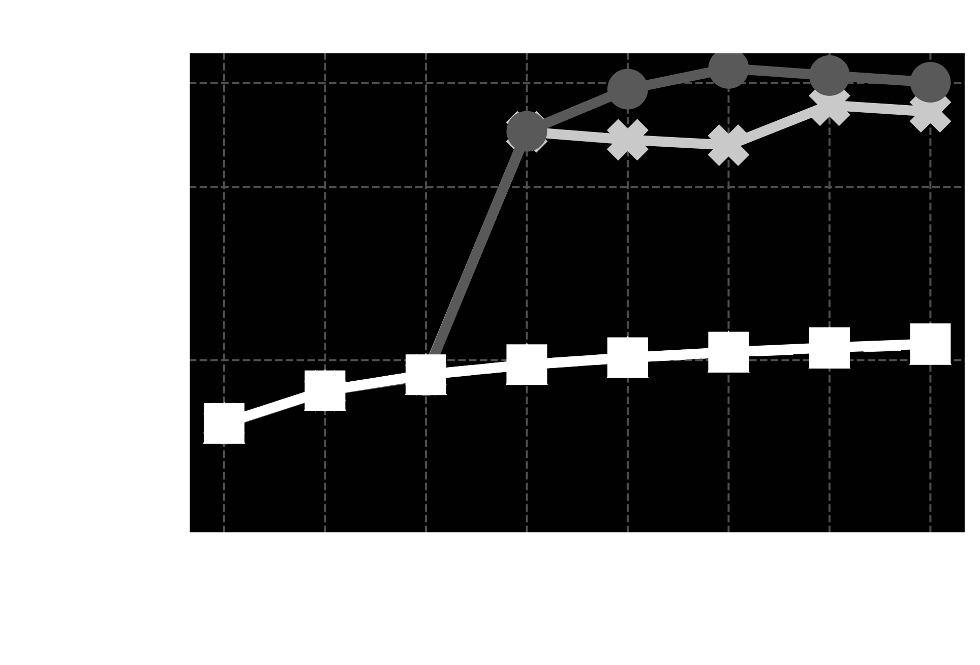
Credence Performs Close to Push-out
ABM
Dynamic Thresholds
Credence & LQD

Slide 81
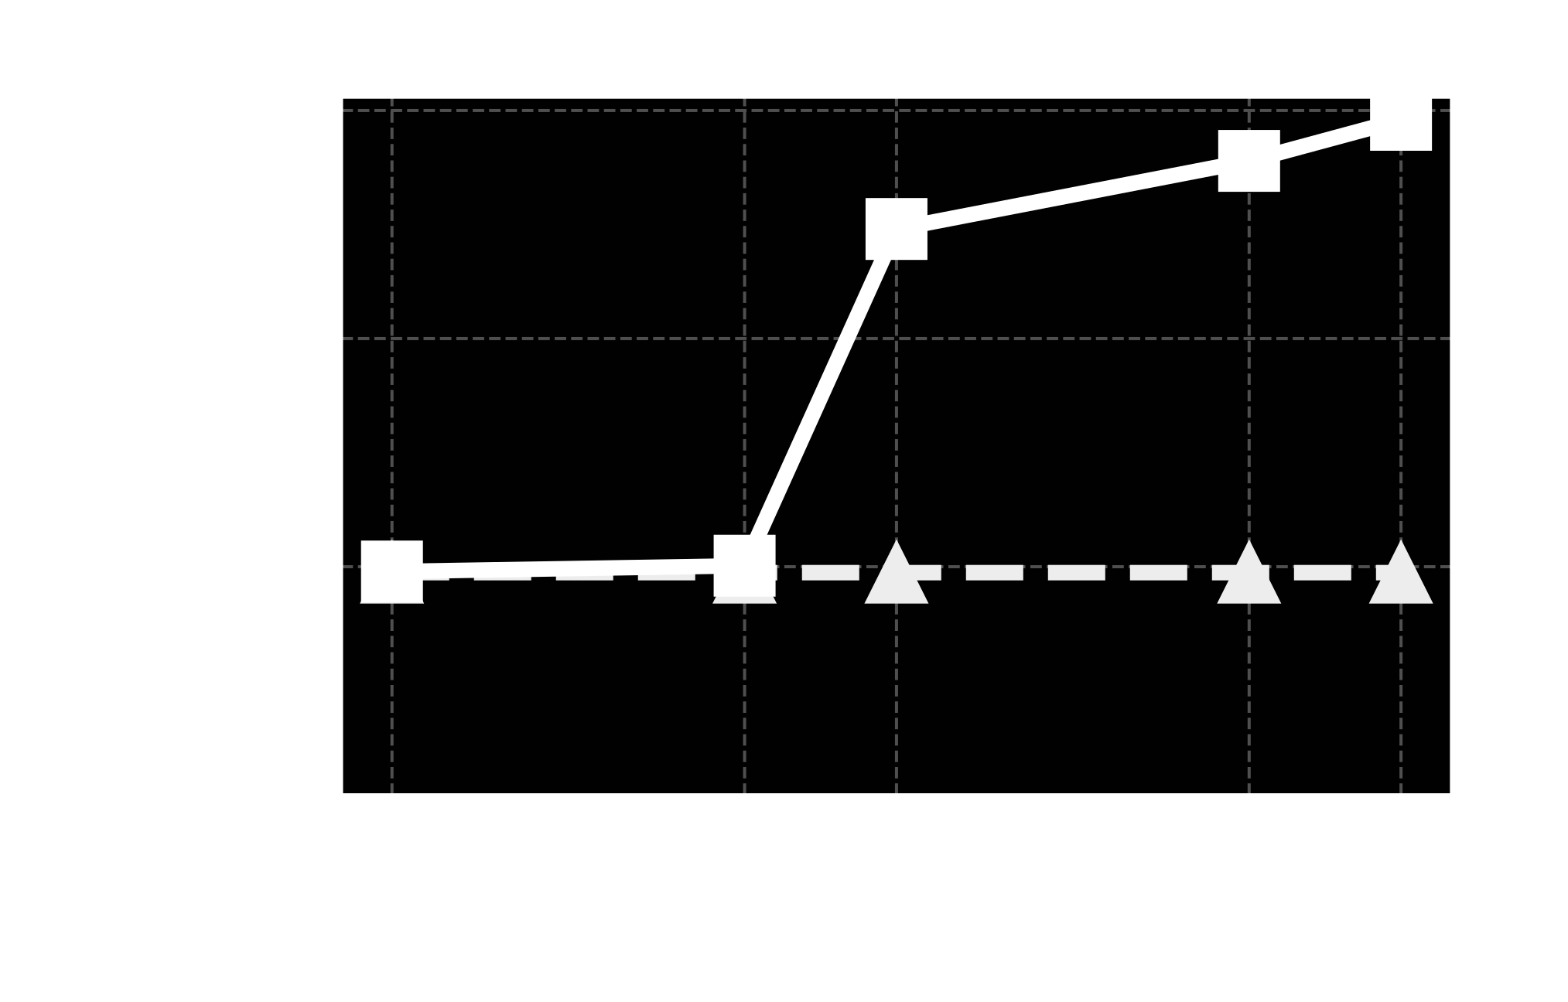
Credence Degrades with Prediction Error
Credence
LQD
(Push-out)

Slide 82
Open Questions and Future Research Directions
Practically training a prediction oracle
Simulation-based data (may not capture real-world scenarios)
Real-world network data (more accurate but complex to obtain)
Online reinforcement learning
…
Understanding push-out operation complexity
Improving the robustness of Credence
Considering latency for competitive analysis

Slide 83
Conclusion
Traditional drop-tail buffer sharing approaches cannot be improved further
Credence is the first buffer sharing algorithm augmented with predictions
Credence offers bounded performance guarantees
Credence can improve the performance of datacenter traffic in terms of flow completion times for short flows and incast flows
Source code: https://github.com/inet-tub/ns3-datacenter

Slide 84

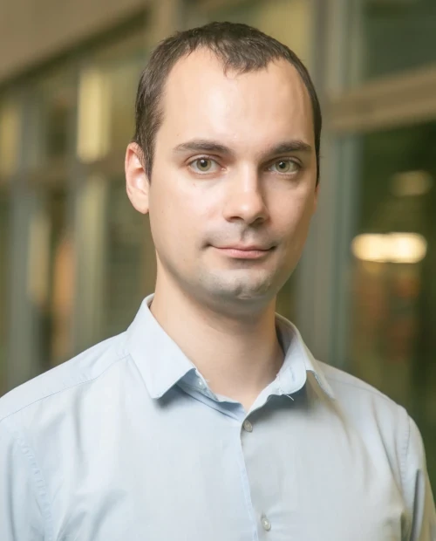
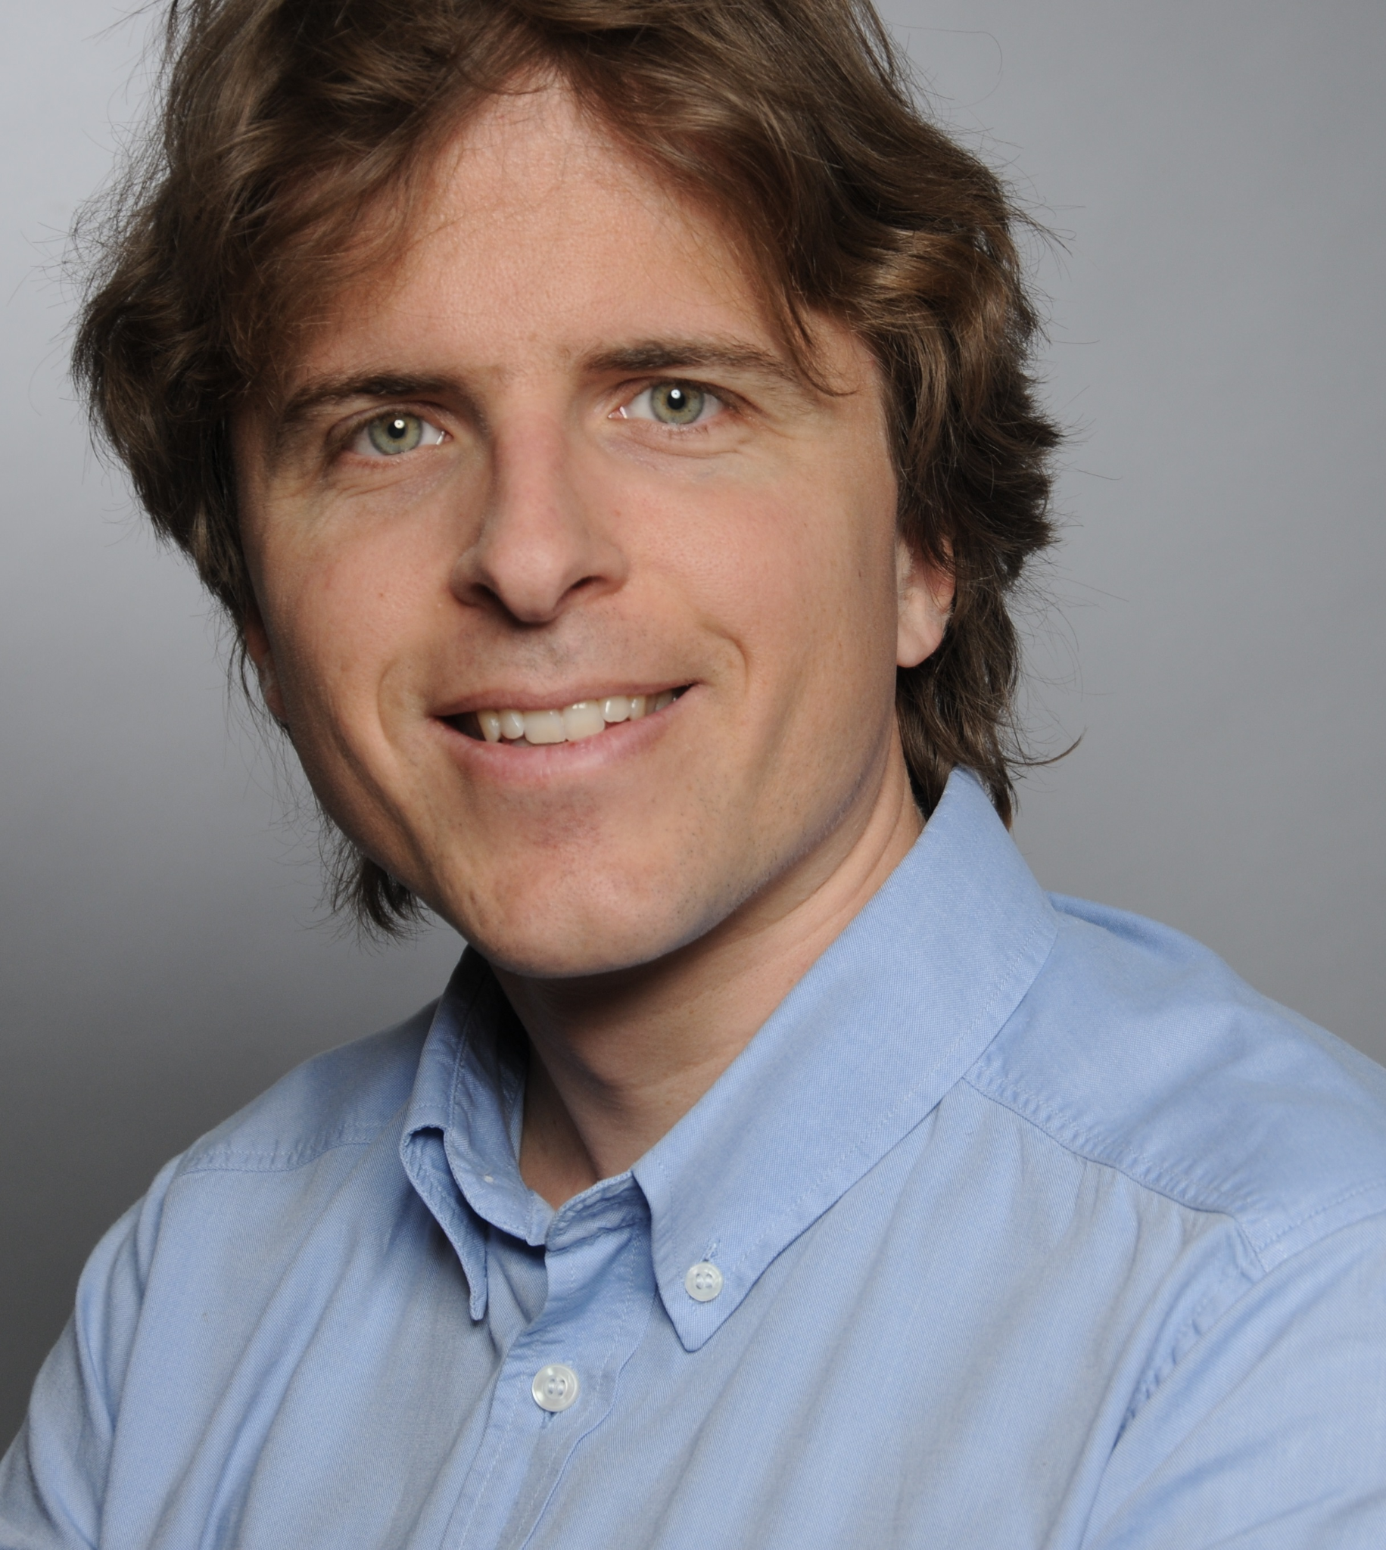

Thank You
Vamsi Addanki
vamsi@inet.tu-berlin.de
@Vamsi_DT
Maciej Pacut
maciej@inet.tu-berlin.de
Stefan Schmid
stefan.schmid@tu-berlin.de
@schmiste_ch

